Slide 1
1
Assistant Academic Educational Site or AAES

Slide 2
2
Group of Work
Our supervisor - Mr.Ahmed Kamal
Hussain Abdu - 438806790
Fawaz Mohammed - 437801110
Ahmed Amer - 437807219

Slide 3
3
Reminder of the problem?
“
Students always face some difficulties with the content of courses, so they try to resort to some external sources, but due to the huge number of external sources with a variety of quality and incompatibility, that may causes confusion to students, and they may obtain an incorrect information in many cases, students as well struggle with the unfamiliar and new type of questions in the exams.
”

Slide 4
4
What was our project?
“
The project is an assistant academic educational site under the name “AAES”, This site help students to get over the obstacles that they face in their courses by providing a good content of the courses. Through different several of questions, forms and also links to good external sources, etc. In addition to other sub-goals that provide a guidance on the right path for those interested in a specific field.
”

Slide 5
Project view
5
AAES

Slide 6
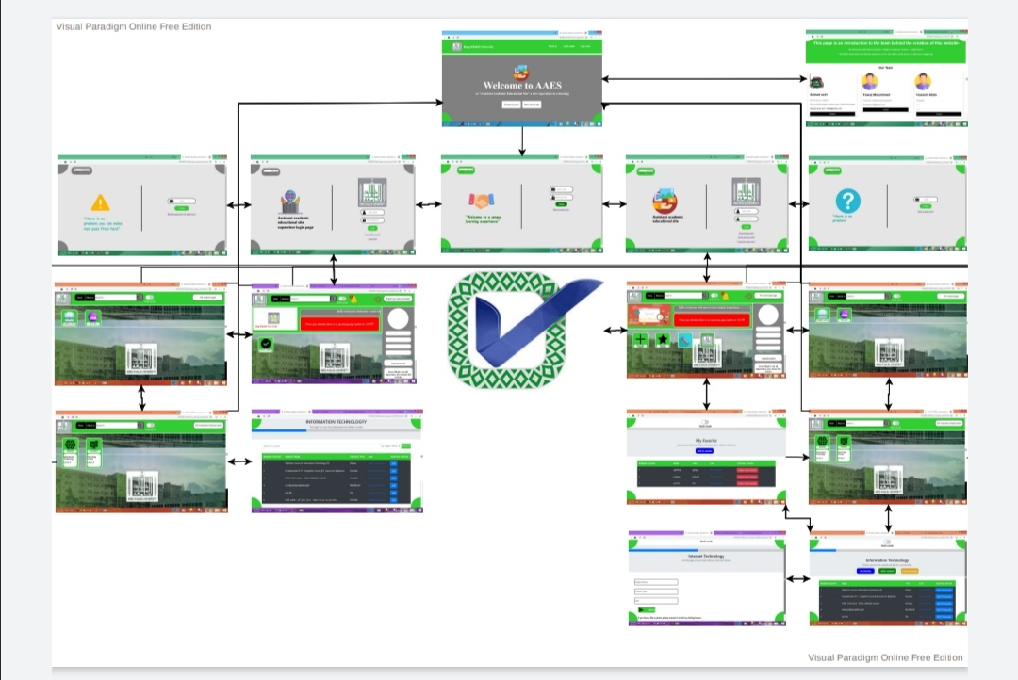
6
Map the website:-

Slide 7
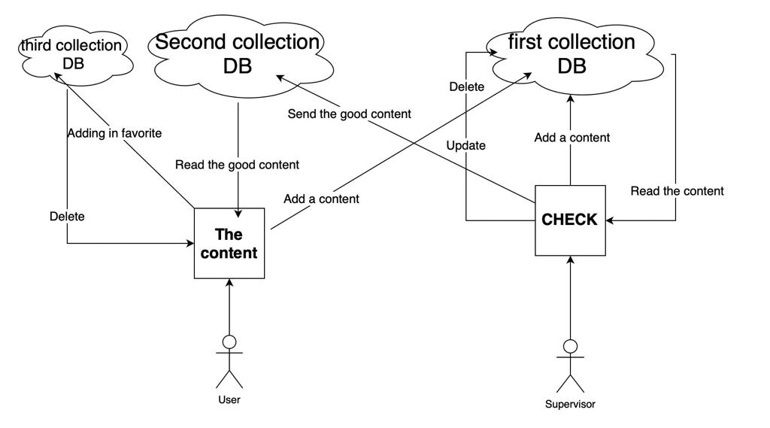
7
The database:-

